Slide 1



Noida Institute of Engineering and Technology, Greater Noida
Computer Networks
Network Layer
Unit: 3
Computer Networks
Ms. Akanksha
ECE
B.Tech VI sem

Slide 2
Content
Functions of Network Layer
IP addressing
IPV4
IPv6
Routing Methods
Distance vector Routing
Link state routing
Congestion control

Slide 3
Course Objective
Introduction of computer networks with suitable transmission media and different networking devices. Network protocols which are essential for the computer network are need to explain such as data link layer protocols and routing protocols.
A detail explanation of IP addressing , TCP/IP protocols and application layer protocols are covered in this course.

Slide 4
Course Outcome
At the end of semester students will be able to
CO1:Explain basic concepts, OSI reference model, services and role of each layer of OSI model and TCP/IP, networks devices and transmission
media, Analog and digital data transmission.
CO2: Apply channel allocation, framing, error and flow control techniques.
CO3: Describe the functions of Network Layer i.e. Logical addressing,
subnetting & Routing Mechanism.
CO4: Explain the different Transport Layer function i.e. Port addressing,
Connection Management, Error control and Flow control mechanism.
CO5: Explain the functions offered by session and presentation layer and their Implementation.
CO6: Explain the different protocols used at application layer i.e. HTTP,
SNMP, SMTP, FTP,TELNET and VPN.

Slide 5
CO-PO and PSO Mapping
Computer Networks(KCS- 603) |  |  |  |  |  |  |  |  | Year of Study: 2020-21
CO | PO1 | PO2 | PO3 | PO4 | PO5 | PO6 | PO7 | PO8 | PO9 | PO10 | PO11 | PO12
KCS603.1 | 3 | 2 | 2 |  | 2 |  |  |  | 2 |  | 2 | 3
KCS603.2 | 3 | 3 | 2 |  |  |  |  |  |  |  |  | 3
KCS603.3 | 3 | 3 | 3 | 3 | 2 |  |  |  | 2 |  | 2 | 3
KCS603.4 | 3 | 2 | 2 |  | 2 |  |  |  |  |  |  | 3
KCS603.5 | 3 | 3 | 2 |  | 2 | 3 |  | 2 |  |  |  | 3
KCS603.6 | 3 | 2 | 2 |  | 2 | 2 | 2 | 2 |  | 2 | 2 | 3

Slide 6
CO-PO and PSO Mapping
CO | PSO1 | PSO2 | PSO3 | PSO4
KCS603.1 | 2 | 2 | 2 | 2
KCS603.2 | 2 | 2 | 2 | 2
KCS603.3 | 2 | 2 | 2 | 3
KCS603.4 | 2 | 2 | 2 | 2
KCS603.5 | 2 | 2 | 2 | 2
KCS606 | 2 | 2 | 2 | 2

Slide 7
Network Layer Functions
Objective: Study about basic concept of Network layer and its function
Getting packets from the source all the way to the destination
May require many hops through intermediate routers.
It must know about the topology of the communication subnet ( the set of all routers) and choose appropriate paths through it.
It must take care to choose routers to avoid overloading some of the lines and routers while leaving others idle.
When source and destination are in different networks, it has to deal with the differences.

Slide 8
Network Layer Functions
Encapsulation - The network layer receives a protocol data unit (PDU) from the transport layer. In a process called encapsulation, the network layer adds IP header information, such as the IP address of the source (sending) and destination (receiving) hosts. After header information is added to the PDU, the PDU is called a packet.
Routing - The network layer provides services to direct packets to a destination host on another network. To travel to other networks, the packet must be processed by a router.
De-encapsulation - When the packet arrives at the network layer of the destination host, the host checks the IP header of the packet. If the destination IP address within the header matches its own IP address, the IP header is removed from the packet. This process of removing headers from lower layers is known as de-encapsulation.

Slide 9
Network Layer

Slide 10
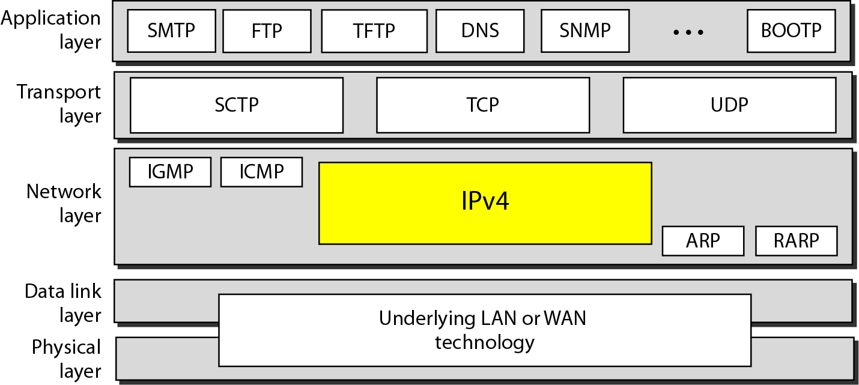
Network Layer Protocols

Slide 11
Network Layer Protocols
There are several network layer protocols in existence; however, only the following two are commonly implemented:
Internet Protocol version 4 (IPv4)
Internet Protocol version 6 (IPv6)
Other legacy network layer protocols that are not widely used include:
Novell Internetwork Packet Exchange (IPX)
AppleTalkConnectionless Network Service (CLNS/DECNet)

Slide 12
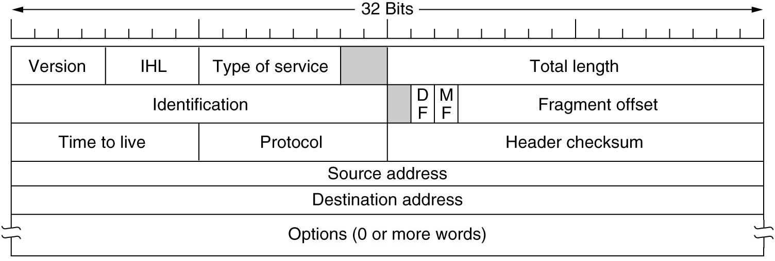
IPv4 Protocol

Slide 13
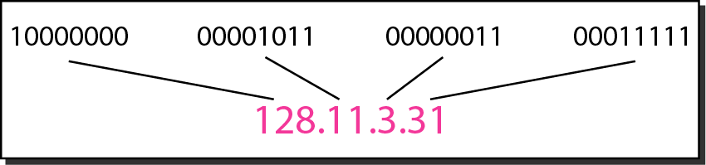
IPv4 Protocol
Objective: Study about basic concept of IP addressing and its type
An IPv4 address is a 32-bit address that uniquely and universally defines the connection of a device (for example, a computer or a router) to the Internet.
The address space of IPv4 is 2³² or 4,294,967,296.
Dotted-decimal notation and binary notation for an IPv4 address

Slide 14
IPv4 Example
Change the following IPv4 addresses from binary notation to dotted-decimal notation.
Solution
We replace each group of 8 bits with its equivalent decimal number (see Appendix B) and add dots for separation.

Slide 15
IPv4 example
Change the following IPv4 addresses from dotted-decimal notation to binary notation.
Solution
We replace each decimal number with its binary equivalent

Slide 16
IPv4 example
Find the error, if any, in the following IPv4 addresses.
Solution
a. There must be no leading zero (045).
b. There can be no more than four numbers.
c. Each number needs to be less than or equal to 255.
d. A mixture of binary notation and dotted-decimal notation is not allowed.

Slide 17
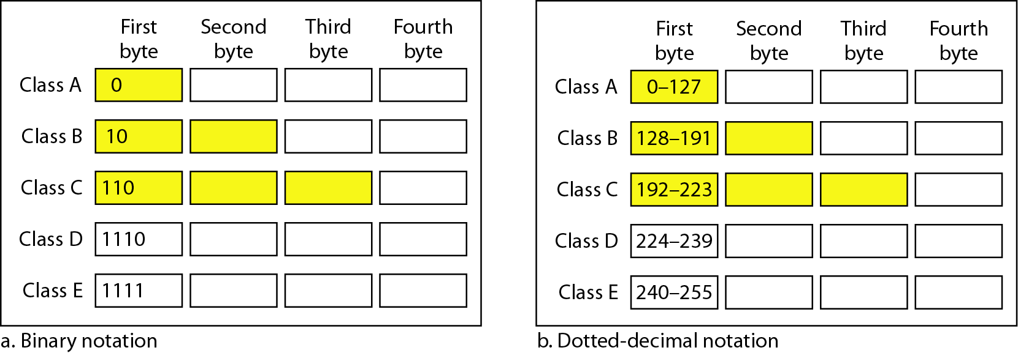
IPv4 address classification
Finding the classes in binary and dotted-decimal notation
In classful addressing, the address space is divided into five classes:
A, B, C, D, and E.

Slide 18
IPv4 address classification
Find the class of each address.
a. 00000001 00001011 00001011 11101111
b. 11000001 10000011 00011011 11111111
c. 14.23.120.8
d. 252.5.15.111
Solution
a. The first bit is 0. This is a class A address.
b. The first 2 bits are 1; the third bit is 0. This is a class C address.
c. The first byte is 14; the class is A.
d. The first byte is 252; the class is E.

Slide 19
IPv4 address classification
Number of blocks and block size in classful IPv4 addressing
In classful addressing, a large part of the available addresses were wasted.
Default masks for classful addressing

Slide 20
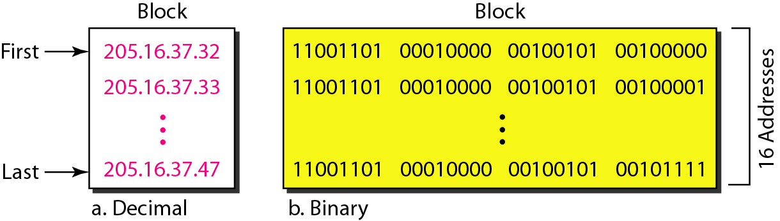
IPv4 address classification
A block of 16 addresses granted to a small organization
Classful addressing, which is almost obsolete, is replaced with classless addressing.

Slide 21
IPv4 address : classless addressing
In IPv4 addressing, a block of addresses can be defined as
x.y.z.t /n
in which x.y.z.t defines one of the addresses and the /n defines the mask.
The first address in the block can be found by setting the rightmost 32 − n bits to 0s.
The last address in the block can be found by setting the rightmost 32 − n bits to 1s.
The number of addresses in the block can be found by using the formula 2^{32−n}.

Slide 22
IPv4 address : classless addressing
Example 19.6
A block of addresses is granted to a small organization. We know that one of the addresses is 205.16.37.39/28. What is the first address in the block?
Solution
The binary representation of the given address is
11001101 00010000 00100101 00100111
If we set 32−28 rightmost bits to 0, we get
11001101 00010000 00100101 0010000
or 205.16.37.32.

Slide 23
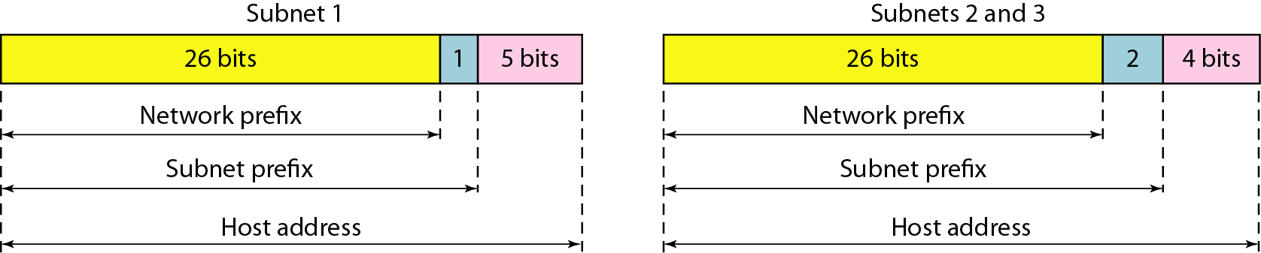
IPv4 address : classless addressing
Three-level hierarchy in an IPv4 address

Slide 24
IPv4 address : classless addressing
An ISP is granted a block of addresses starting with 190.100.0.0/16 (65,536 addresses). The ISP needs to distribute these addresses to three groups of customers as follows:
The first group has 64 customers; each needs 256 addresses.
b. The second group has 128 customers; each needs 128 addresses.
c. The third group has 128 customers; each needs 64 addresses.
Design the sub blocks and find out how many addresses are still available after these allocations.

Slide 25
IPv4 address : classless addressing
Group 1
For this group, each customer needs 256 addresses. This means that 8 (log2 256) bits are needed to define each host. The prefix length is then 32 − 8 = 24. The addresses are

Slide 26
IPv4 address : classless addressing
Example 19.10 (continued)
Group 2
For this group, each customer needs 128 addresses. This means that 7 (log2 128) bits are needed to define each host. The prefix length is then 32 − 7 = 25. The addresses are

Slide 27
IPv4 address : classless addressing
Example 19.10 (continued)
Group 3
For this group, each customer needs 64 addresses. This means that 6 (log₂64) bits are needed to each host. The prefix length is then 32 − 6 = 26. The addresses are
Number of granted addresses to the ISP: 65,536
Number of allocated addresses by the ISP: 40,960
Number of available addresses: 24,576

Slide 28
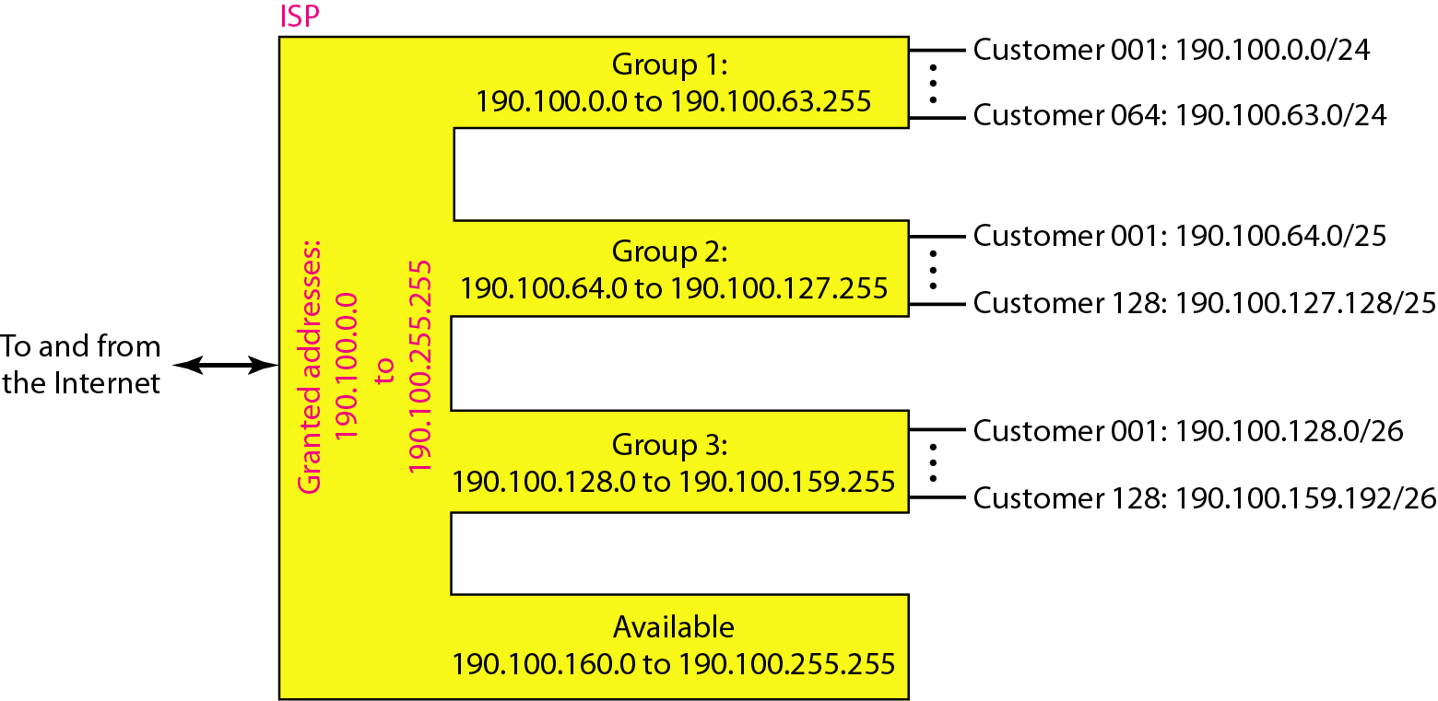
IPv4 address : classless addressing
An example of address allocation and distribution by an ISP

Slide 29
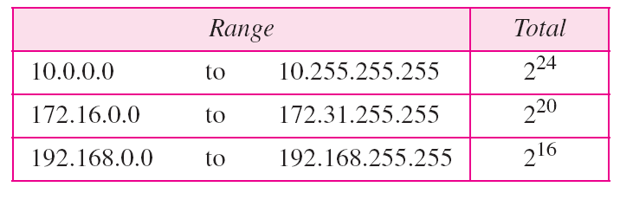
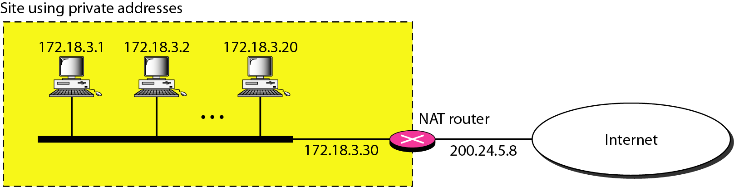
IPv4 address : classless addressing
Addresses for private networks

Slide 30
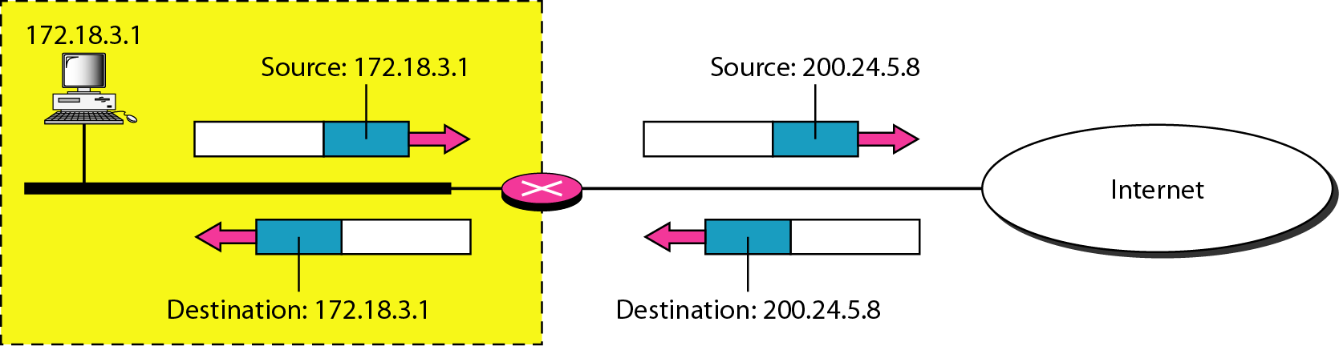
IPv4 address
Addresses in a NAT

Slide 31
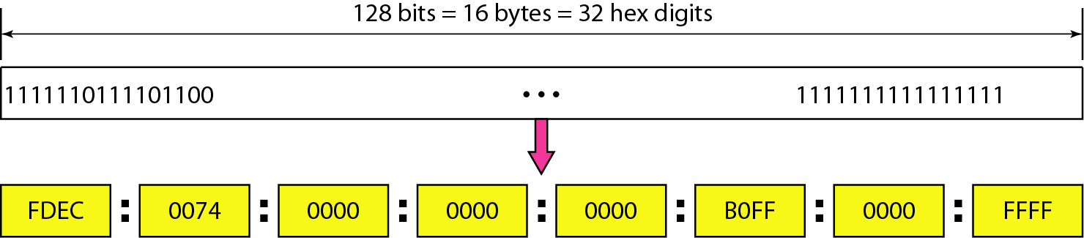
IPv6 address
Objective: Study about basic concept of IPv6 and its function
Despite all short-term solutions, address depletion is still a long-term problem for the Internet. This and other problems in the IP protocol itself have been the motivation for IPv6
An IPv6 address is 128 bits long.

Slide 32
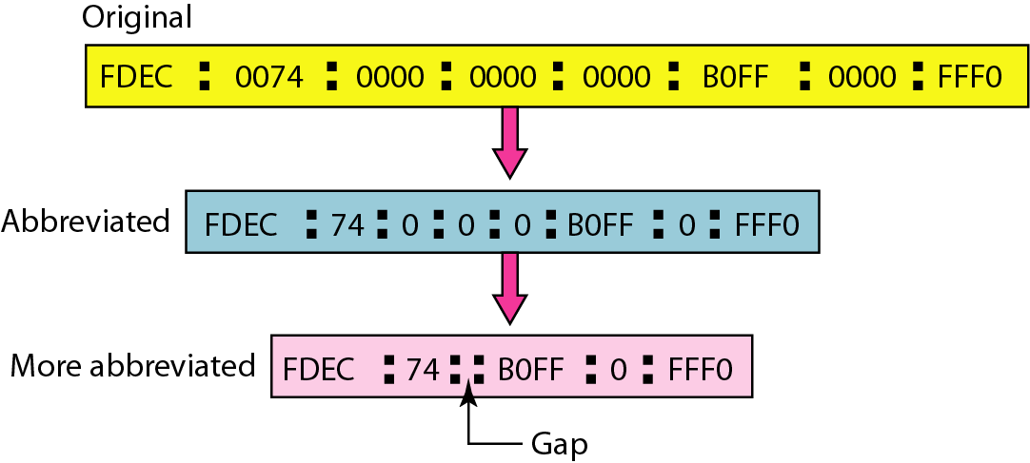
IPv6 address
IPv6 address in binary and hexadecimal colon notation

Slide 33
IPv6 address
Expand the address 0:15::1:12:1213 to its original.
Solution
We first need to align the left side of the double colon to the left of the original pattern and the right side of the double colon to the right of the original pattern to find how many 0s we need to replace the double colon.
This means that the original address is.

Slide 34
IPv6 address
IPv6 address in binary and hexadecimal colon notation

Slide 35
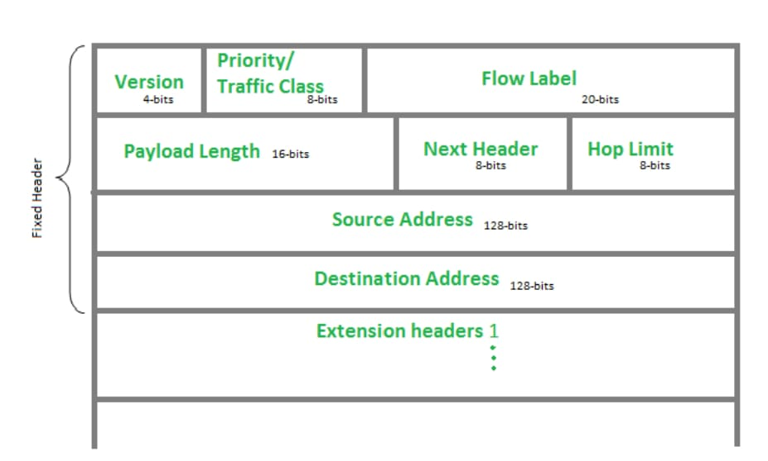
IPv6 Protocol

Slide 36
Routing
Objective: Study about basic concept of Routing and its type
An internet is a combination of networks connected by routers. When a datagram goes from a source to a destination, it will probably pass through many routers until it reaches the router attached to the destination network.

Slide 37
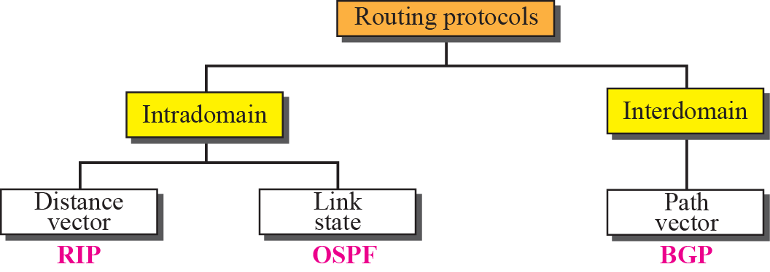
Routing

Slide 38
Routing
DISTANCE VECTOR ROUTING: Updating of Routing table
If the next-node entry is different
The receiving node chooses the row with the smaller cost
If there is a tie, the old one is kept
If the next-node entry is the same
i.e. the sender of the new row is the provider of the old entry
The receiving node chooses the new row, even though the new value is infinity.

Slide 39
Routing
Periodic Update
A node sends its routing table, normally 30 seconds, in a periodic update
Triggered Update
A node sends its routing table to its neighbors any time when there is a change in its routing table
1. After updating its routing table, or
2. Detects some failure in the neighboring links

Slide 40
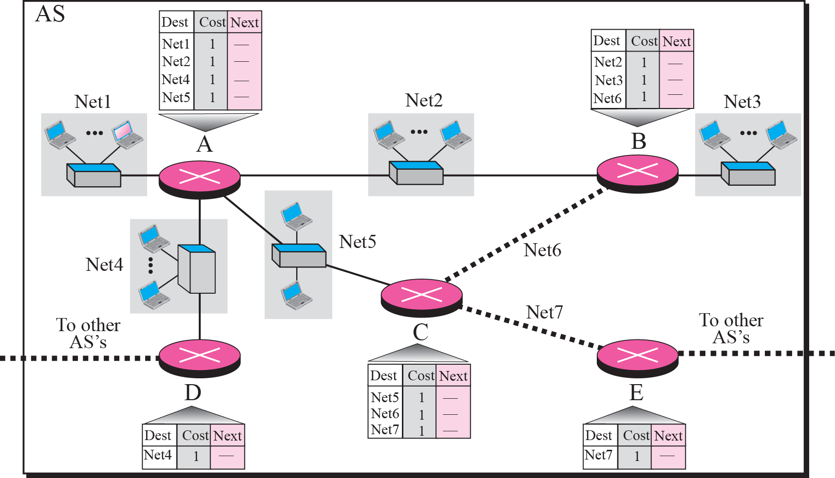
Routing
Figure shows the initial routing table for an AS. Note that the figure does not mean that all routing tables have been created at the same time; each router creates its own routing table when it is booted.

Slide 41
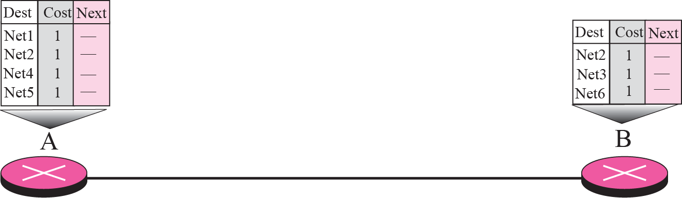
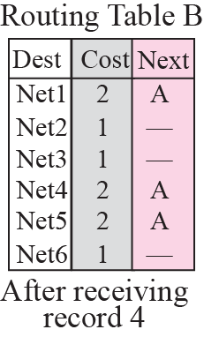
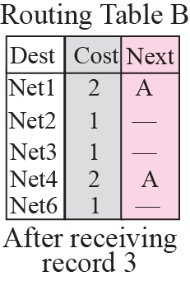
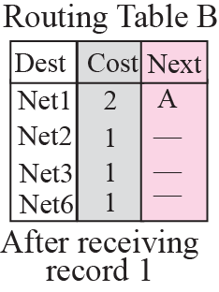
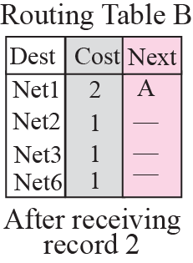
Routing
Now assume router A sends four records to its neighbors, routers B, D, and C. shows the changes in B’s routing table when it receives these records.

Slide 42
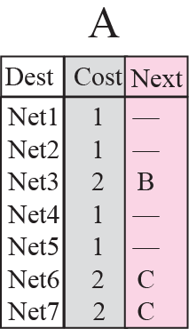
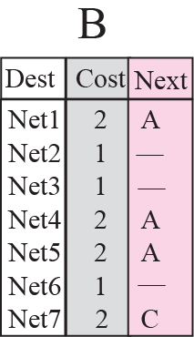
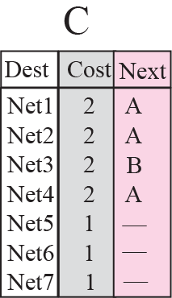
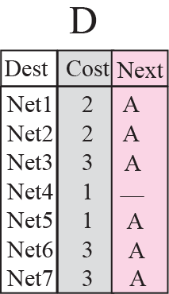
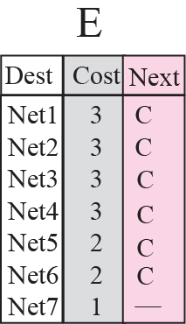
Routing

Slide 43
Routing
The Routing Information Protocol (RIP) is an intra-domain (interior) routing protocol used inside an autonomous system. It is a very simple protocol based on distance vector routing. RIP implements distance vector routing directly with some considerations.

Slide 44
Routing: Link state Routing
Link state routing has a different philosophy from that of distance vector routing. In link state routing, if each node in the domain has the entire topology of the domain—the list of nodes and links, how they are connected including the type, cost (metric), and the condition of the links (up or down)—the node can use the Dijkstra algorithm to build a routing table.

Slide 45
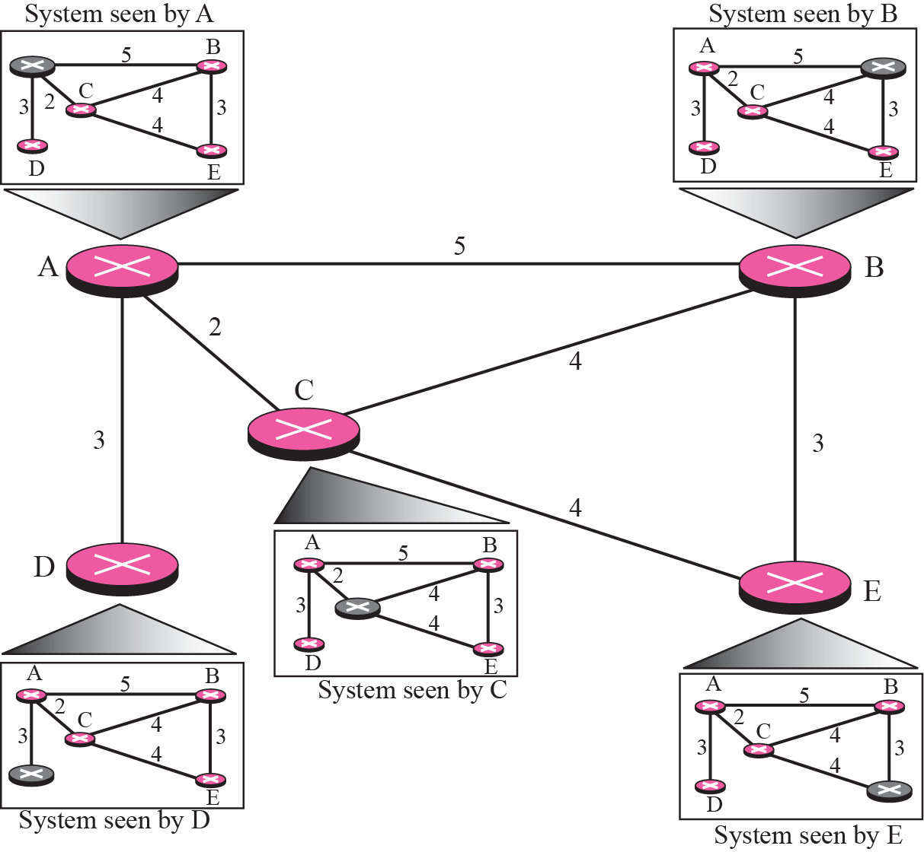
Routing

Slide 46
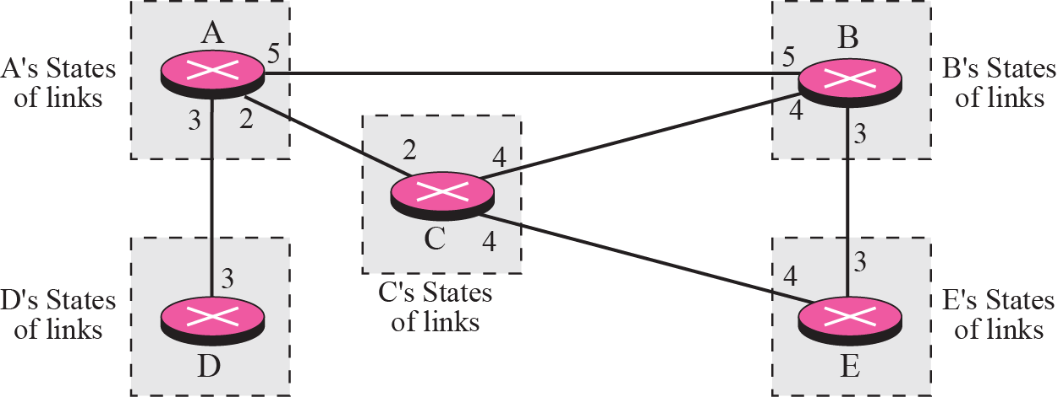
Routing

Slide 47
Routing
Building Routing Tables
Creation of the states of the links by each node, called the link state packets (LSP)
Dissemination of LSPs to every other routers, called flooding (efficiently)
Formation of a shortest path tree for each node
Calculation of a routing table based on the shortest path tree

Slide 48
Routing
Creation of LSP
LSP data: the node ID, the list of links, a sequence number, and age.
LSP Generation
When there is a change in the topology of the domain
On a periodic basis
There is no actual need for this type of LSP, normally 60 minutes or 2 hours

Slide 49
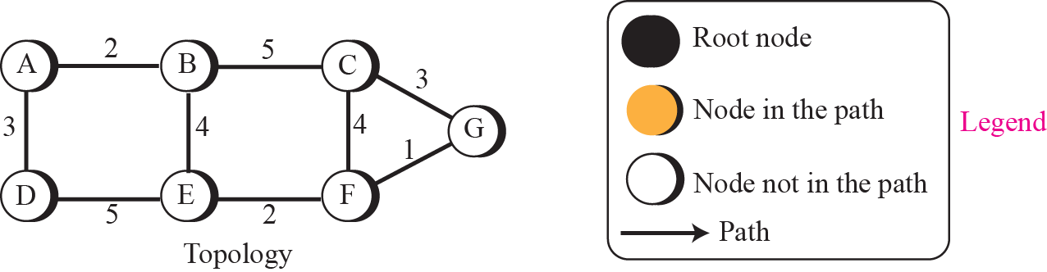
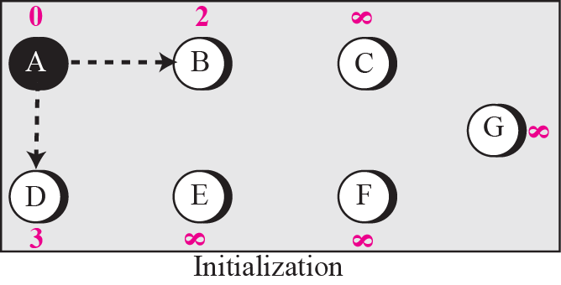
Routing
Forming shortest path three for router A in a graph

Slide 50
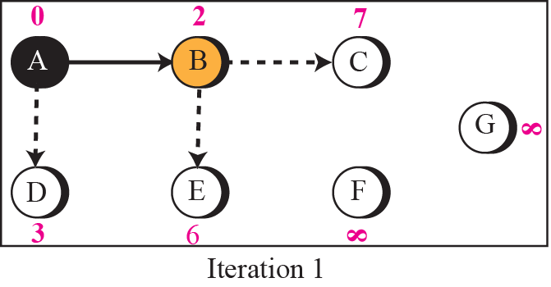
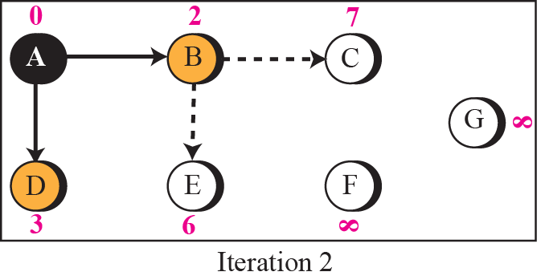
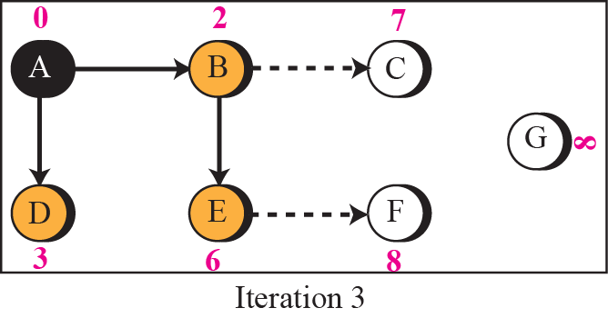
Routing

Slide 51
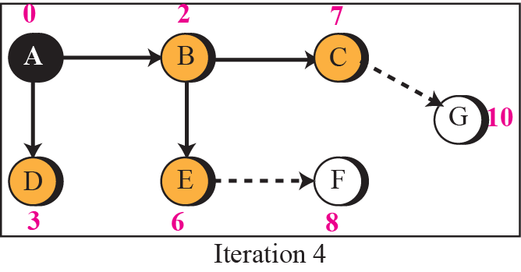
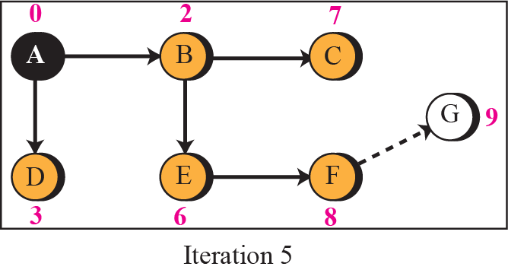
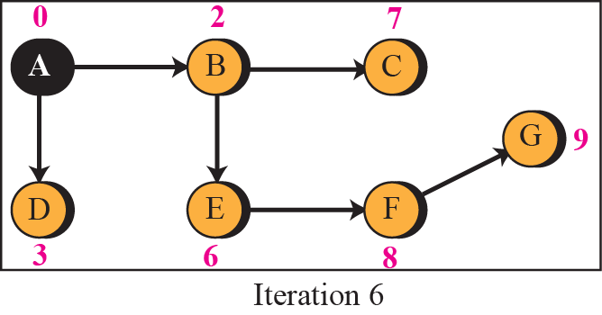
Routing

Slide 52
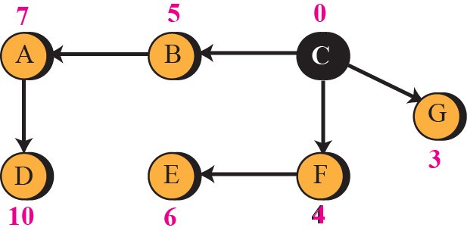
Routing
To show that the shortest path tree for each node is different, we found the shortest path tree as seen by node C.

Slide 53
Routing

Slide 54
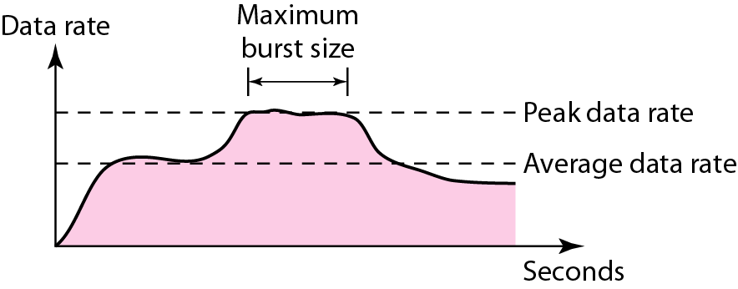
Congestion Control
Objective: Study about basic concept of congestion control and its type
Data traffic
The main focus of congestion control and quality of service is data traffic. In congestion control we try to avoid traffic congestion. In quality of service, we try to create an appropriate environment for the traffic. So, before talking about congestion control and quality of service, we discuss the data traffic itself.
Traffic descriptors

Slide 55
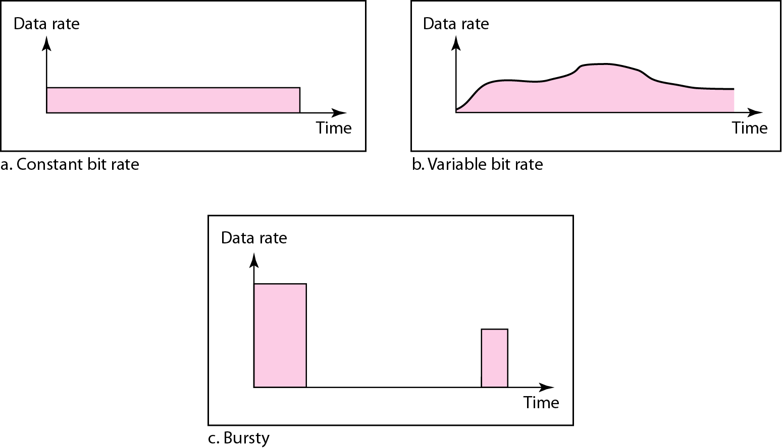
Congestion Control
Three traffic profiles

Slide 56
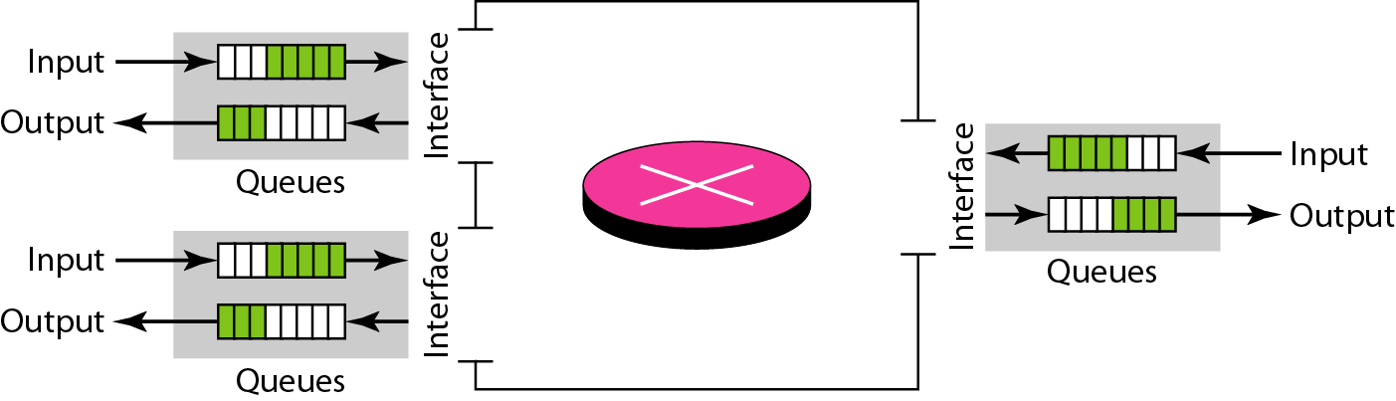
Congestion Control
Congestion in a network may occur if the load on the network—the number of packets sent to the network—is greater than the capacity of the network—the number of packets a network can handle. Congestion control refers to the mechanisms and techniques to control the congestion and keep the load below the capacity.
Queues in a router

Slide 57
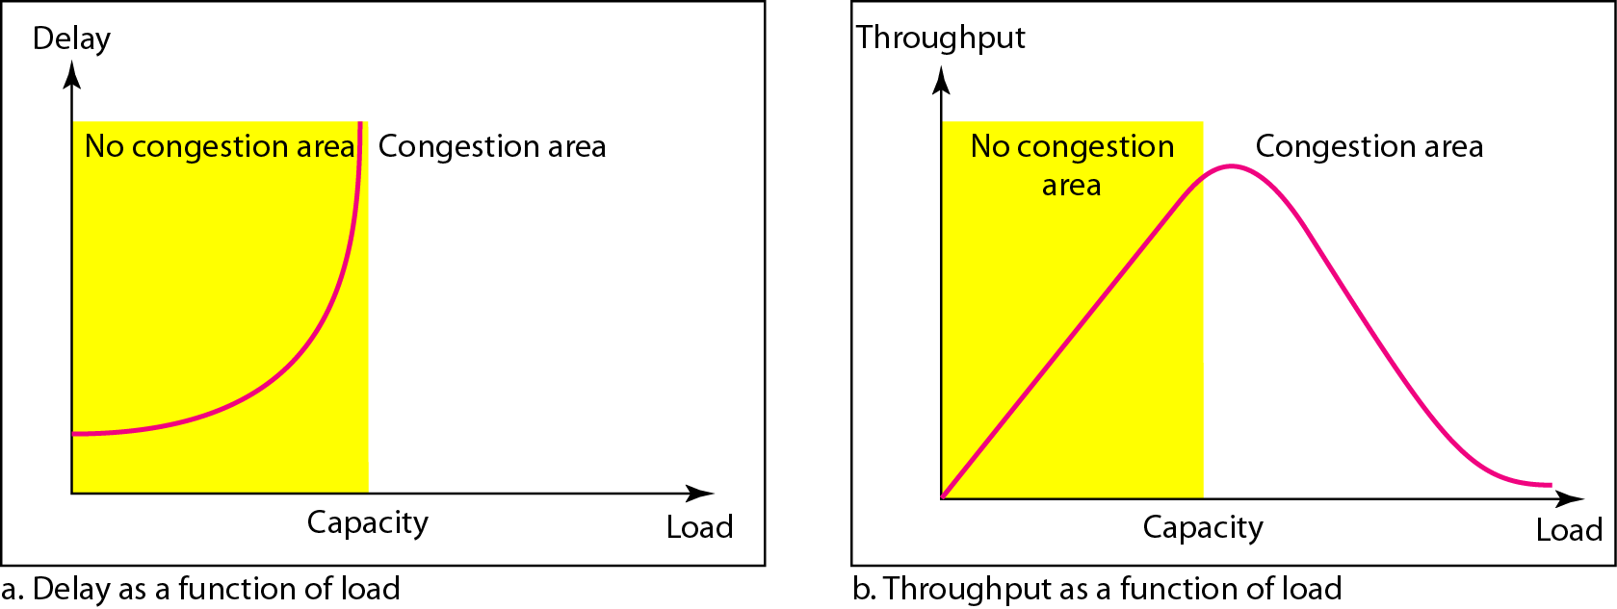
Congestion Control
Packet delay and throughput as functions of load

Slide 58
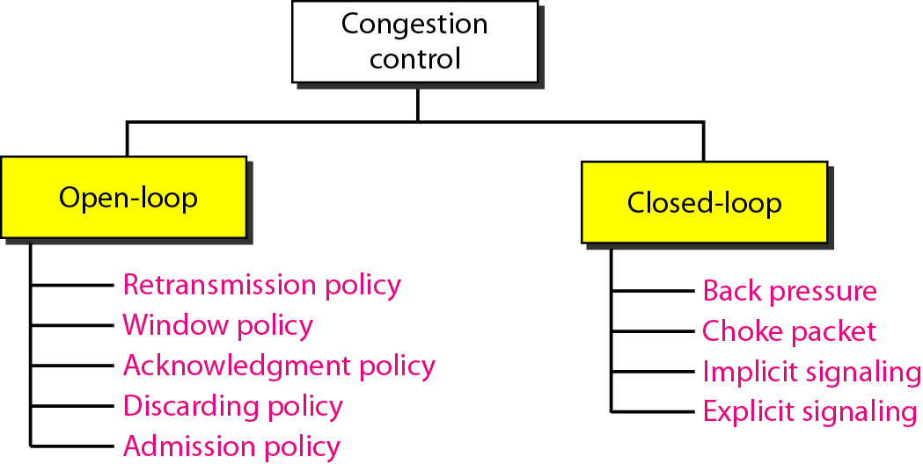
Congestion Control
Congestion control categories

Slide 59
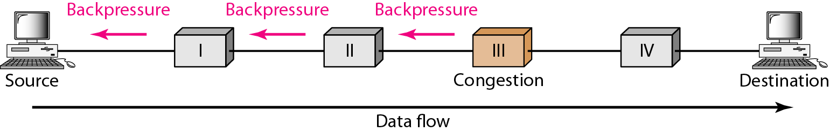
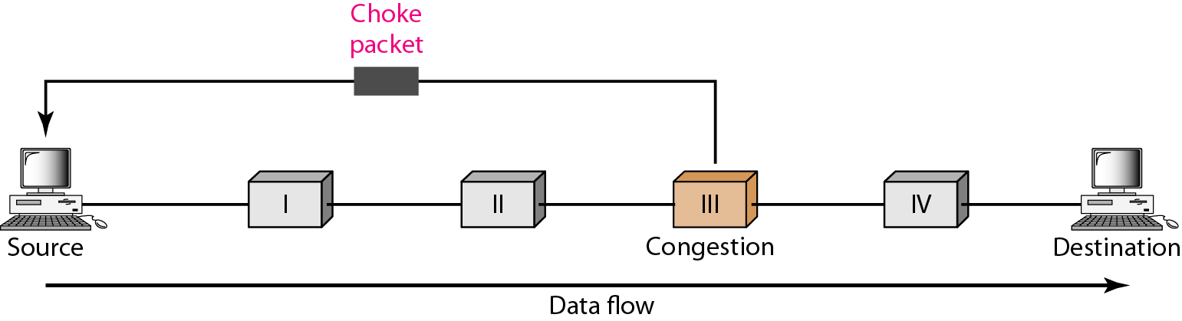
Congestion Control
Backpressure method for alleviating congestion
Choke packet

Slide 60
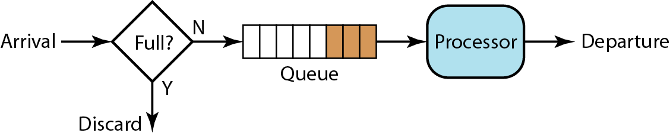
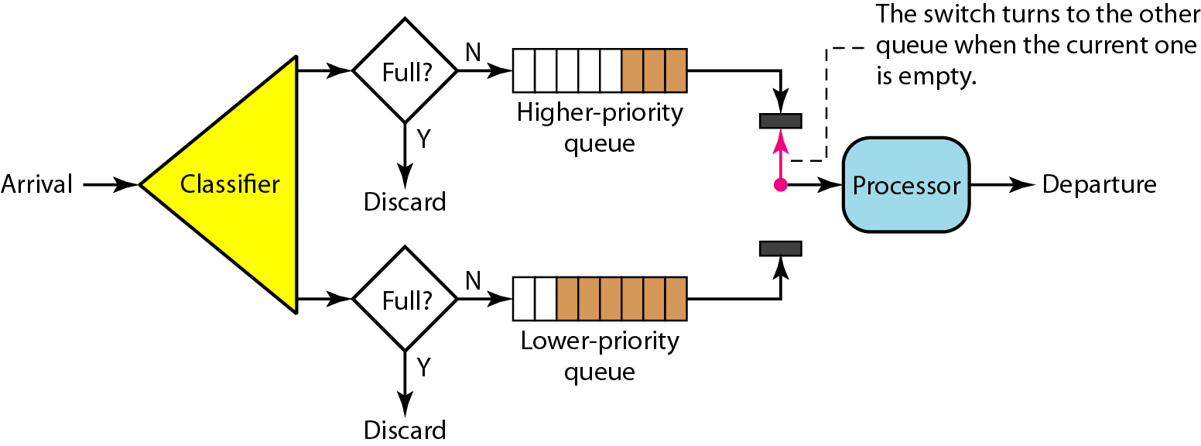
Congestion Control
FIFO queue
Priority queuing

Slide 61
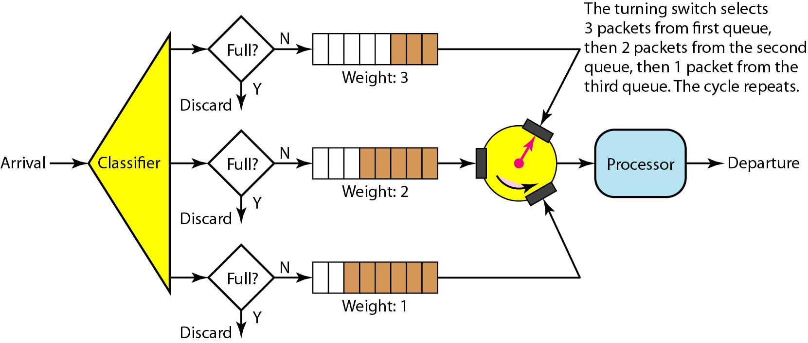
Congestion Control
Weighted fair queuing

Slide 62
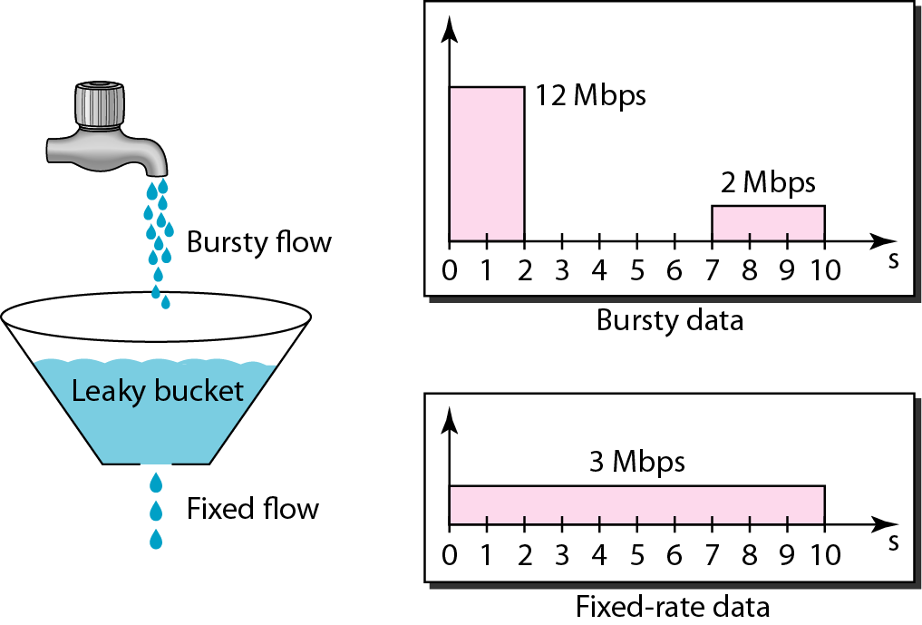
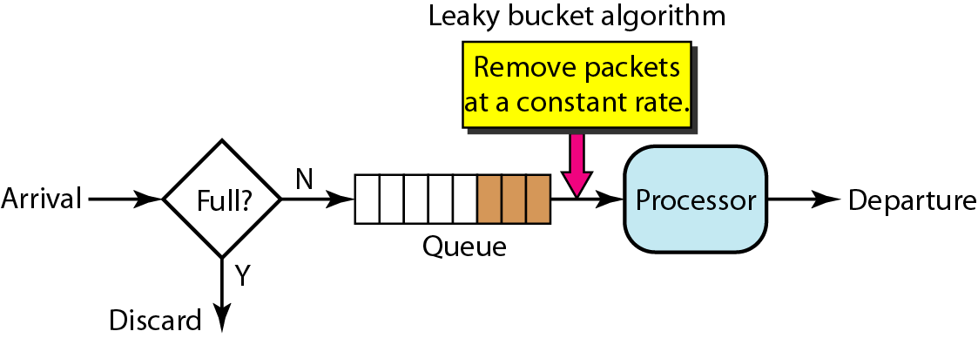
Congestion Control
Leaky bucket
A leaky bucket algorithm shapes busty traffic into fixed-rate traffic by averaging the data rate. It may drop the packets if the bucket is full.
Leaky bucket implementation

Slide 63
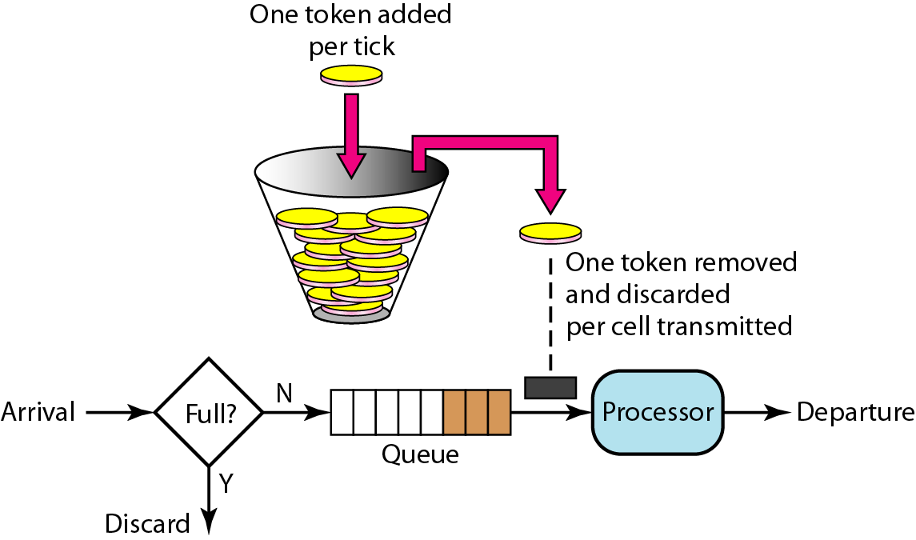
Congestion Control
Token bucket

Slide 64
Faculty Video Links, Youtube & NPTEL Video Links and Online Courses Details
You tube/other Video Links
https://www.youtube.com/watch?v=aqtd8iZlSAA
https://www.youtube.com/watch?v=JhBnOamc_8s

Slide 65
Daily Quiz
1. Routing tables of a router keeps track of
A. MAC Address Assignments B. Port Assignments to network devices C. Distribute IP address to network devices D. Routes to use for forwarding data to its destination
2. What is the use of Ping command? A. To test a device on the network is reachable B. To test a hard disk fault C. To test a bug in an Application D. To test a Pinter Quality
3. Router and 3 layer switch work on which layer of OSI model.
A. Physical layer B. Data Link layer C. Network layer D. None

Slide 66
Daily Quiz
Which is correct for IPv4 and IPv6 A. 32 & 128 B. 32 & 48 C. 48 & 128 D. 64 & 132
Find out wrong IP address A. 192.168.2.50 B.168.02.34.1 C. 127.0.0.0 D. 111.2.56.39
Class C IP address default mask address
A. 255.0.0.0 B. 255.255.255.0 C. 255.255.0.0 D. None
Hub work on which layer of OSI model
A. Physical layer B. Data Link layer C. Network layer D. None
8. Main function of network layer of OSI model
A. Routing B. Logical addressing C. Both A&B D. None
9. Which IP address version have five classes
A. IPv4 B. IPv6 C. Both A & B D. None
10. Supernetting found in which type of IP addresses
A. Classfull B. Classless C. Both A &B D. None

Slide 67
Weekly Assignment
1. A computer on 6 mbps network is regulated by a token bucket
The token bucket is filled at a rate of 1 mbps. It is initially Filled to capacity with 8 mega bits. How long can the Computer transmit at the full 6 mbps.
Solution: S=C/(M-P)=8/(6-1)=1.6 sec (CO2)
Ans
Capacity C=8 Mb
S Burst length in sec
M=6Mbps
P=1 Mbps

Slide 68
MCQ s
1. Which of the following is true of the IP address 192.0.0.10? (CO4)
A) The netid is 192. B) The hostid is 0.10. C) The network address is 192.0.0.0. D) none of the above
2. A subnet mask in class A has 14 1s. How many subnets does it define? (CO4)
A) 32 B) 8 C) 64 D) none of the above

Slide 69
MCQ s
3. Given the IP address 201.14.78.65 and the subnet mask 255.255.255.224, what is the subnet address? (CO4)
A) 201.14.78.32 B) 201.14.78.65 C) 201.14.78.64 D) none of the above
4. Routers function in the _______ layers. (CO4)
A) physical and data link B) physical, data link, and network C) data link and network D) none of the above

Slide 70
Old Question Papers
http://www.ululu.in/computer-networks-solved-sample-papers-btech-6th-semester/

Slide 71
Expected Questions for University Exam
Compare routers and gateways. (CO4)
Write the IP address range of each class. (CO4)
3. Explain the need of subnet. (CO4)
4. Write acronym for ARP, RARP, ICMP(CO4)
For the given IP address 192.168.2.9 find the class, network address and host address. (CO4)
Write down default mask for each class IP address. (CO4)
Write down subnet mask for given 192.12.3.9/26 IP address. (CO4)
List the functions of network layer. (CO4)

Slide 72
Summary
In this unit 3 we have studied about Network layer of OSI model, its functions and how it handles the packet received from transport layer. Routing methods are also explained and comparison IPv4 and IPv6 completed.
To manage the traffic congestion control is covered.

Slide 73
References
Books:
Forouzen, "Data Communication and Networking",TMH
A.S. Tanenbaum, Computer Networks, Pearson Education
W. Stallings, Data and Computer Communication, MacmillanPress
Thank You

